Slide 1
Title: Restaurant Review Classification based on location using Natural Language Processing
GitHub Repository
https://github.com/yuvi1323/Restaurant-Review-Classification-based-on-location-using- Natural-Language-Processing
Team Members
Yuva Raj Jami -11690083

Slide 2
Goals and Objectives
Motivation​:
Restaurant reviews are a valuable source of information to identify potential customers needs and, they can even help people decide where to eat, what to order, and whether a restaurant is worth visiting.
However, understanding feedback from customers can be time-consuming as it requires inspection of multiple reviews for restaurants.
The idea of this project is to help people with respect to reviews by creating a Natural Language Processing model that classifies restaurant reviews as positive, negative, and neutral.
This model could be used to create a website or app that allows business owners to find information quickly and easily.
Significance:
This project uses Natural Language Processing, this project could significantly impact the restaurant industry based on specific locations like Denton or Dallas.
By simplifying the process of collecting and analyzing restaurant real-time reviews, businesses might improve their reputation and attract more customers.
User feedback frequently includes a variety of mistakes, including typos and spacing errors.
Genuine reviews that enhance the worth of their restaurants are advantageous to restaurant owners.
Additionally, the project could help consumers save time and money by making it easier for them to find restaurants that they are likely to enjoy.

Slide 3
Goals and Objectives
Objectives​:
Develop an NLP model to classify restaurant reviews as positive, negative, or neutral.
Using Google Maps Platform Places APIs (Free location-specific reviews Ex: 1000 Reviews/day) and they be analyzed using our NLP model.
Reviews based on specific locations of city or state using Google and evaluating the performance of the model on a held-out test set.
Building the model in such way that it can be deployed into production so that it can be used by others to classify restaurant.
Features:
Utilizing web scrapping to gather data tailored to a specific geographical area.
The NLP model will be trained on a dataset of restaurant reviews based on labeled as generic labels like positive, negative, or neutral.
Comparison and analysis of review information between unprocessed and preprocessed data.
The model makes it easier to collect real-time location-based data and allows additional analysis.
The model will learn to identify the features of restaurant reviews associated with each sentiment category.

Slide 4
Background Task
Feature Extraction:
One of the main methods used in this study is feature extraction, which calls on the important use of many different types of Natural Language Processing techniques, like sentiment analysis and model accuracy testing. The data was then analyzed by breaking the phrases up into individual words or by cleaning them up based on predetermined standards, such as eliminating punctuation marks and stop words.
https://ieeexplore.ieee.org/document/8999624
Sentiment Analysis:
Performing a sentiment analysis and getting data frames as Data (Reviews) and sentiment (Positive, Negative , Neutral) is important as we will use this for visualizations in next steps.
https://ieeexplore.ieee.org/document/8884282
Text Modeling:
By performing a sentiment analysis on restaurant reviews using text modeling with a RandomForestClassifier. For feature extraction (TF-IDF vectorization) and model training/testing, it makes use of the Scikit-learn library. To build a classification report that shows precision, recall, and the F1-score for each sentiment class (positive, negative, and neutral).
And then using the analyzed data, divides it into training and testing sets, transforms the text data, Tests and trains a RandomForestClassifier model, predicts sentiment labels for the test data set, and analyzes model accuracy.
https://ieeexplore.ieee.org/document/1316850

Slide 5
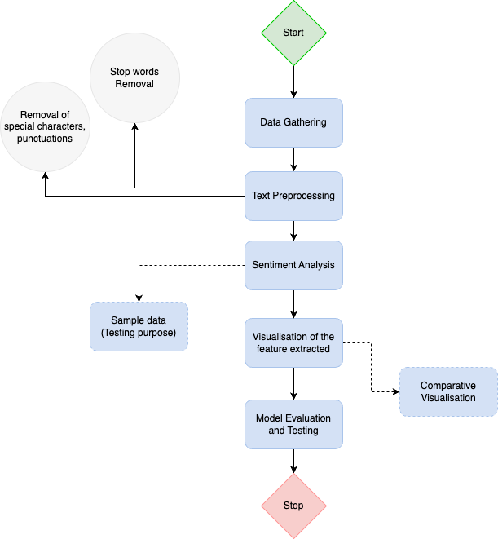
Workflow Diagram
Restaurant Review Analysis

Slide 6
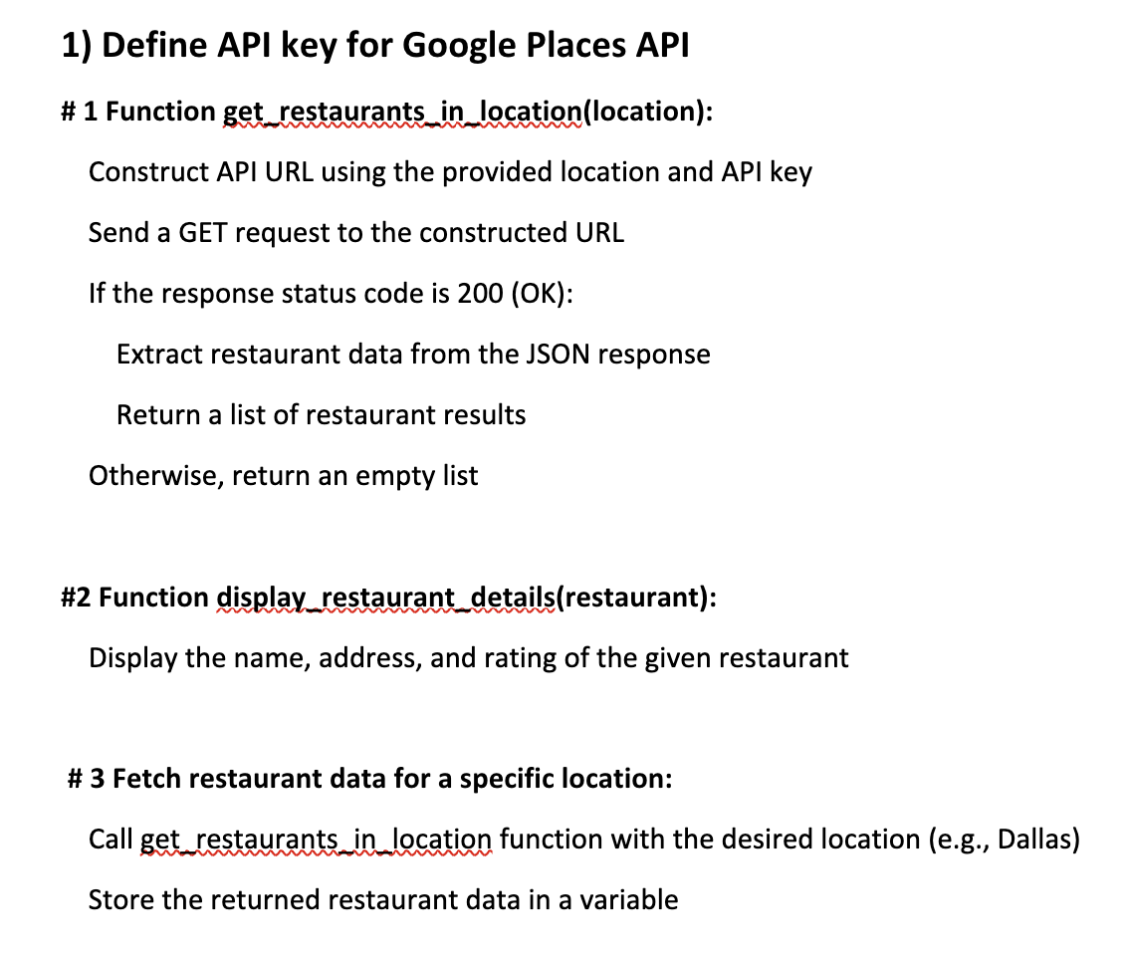
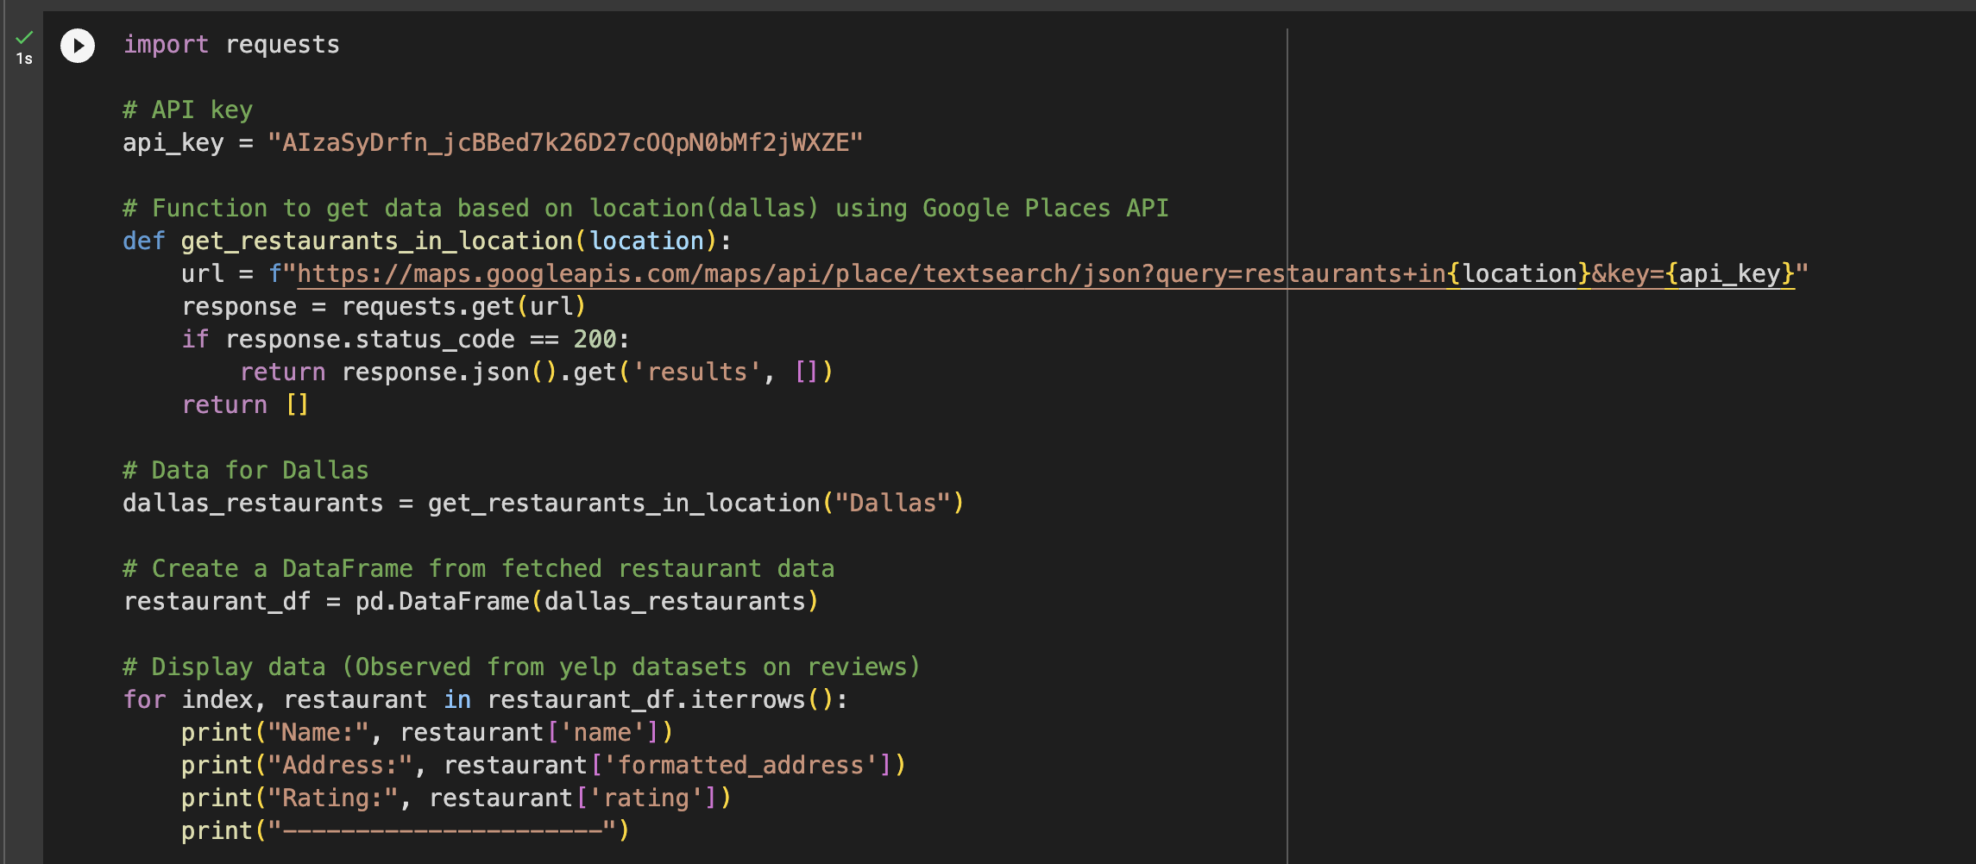
Dataset
The Yelp dataset is a large community database containing detailed information about restaurants, businesses, and orders. I came across the data frames needed for the analysis of restaurant reviews when going through the documentation. I used the Google Places API to collect real-time review data to perform Sentiment Analysis in order to remove errors and to analyze user needs.
Each time a user writes a review for a particular restaurant at a given location, this API gives the most recent information. We may retrieve and review information related to each place in real-time by gaining access to this dynamic data.
Pseudo Code:
Source Code:

Slide 7
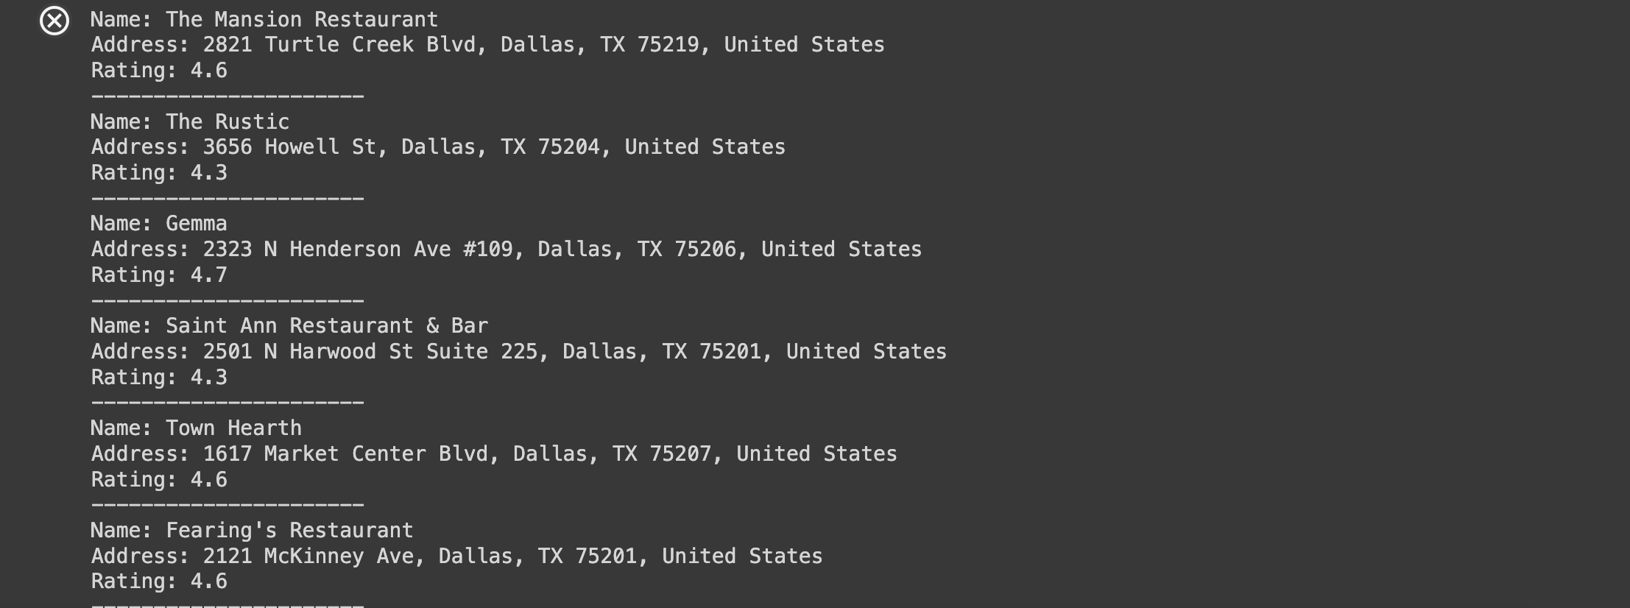
Dataset | Output
Using the Google Places API key we have developed a method that uses the API, to retrieve reviews for a given location and return the reviews.
With this we have obtained the information and collected reviews from different restaurants in Dallas location(100 records/1 API call, max 1000 records can be collected ). It was then converted into a separated csv file, at this point of time it is an unprocessed data.
That helps us to compare with end results of processed data, and how it can be helpful in many ways.
Data Ouput: Few records are show in in this image

Slide 8
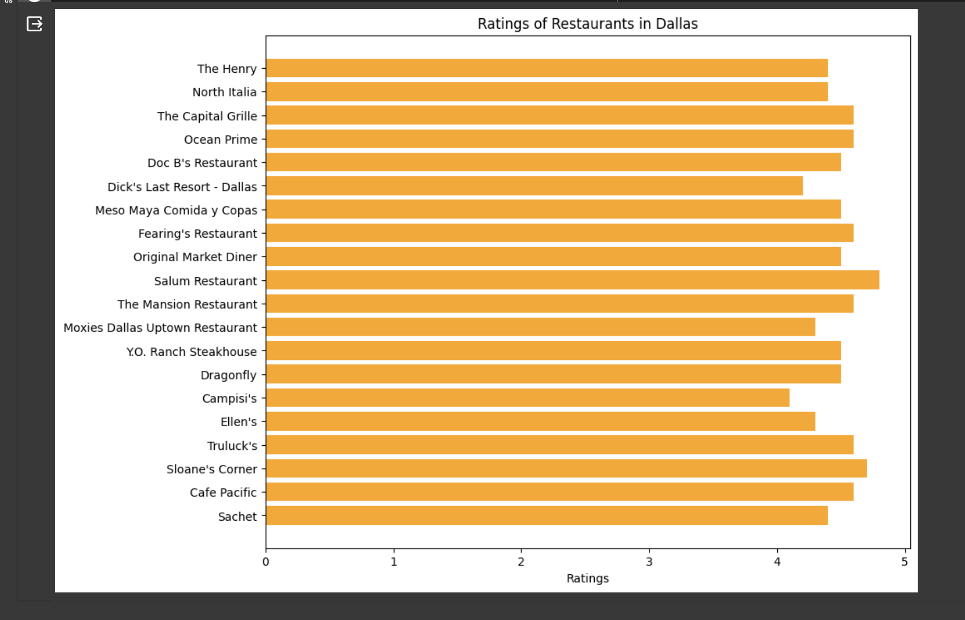
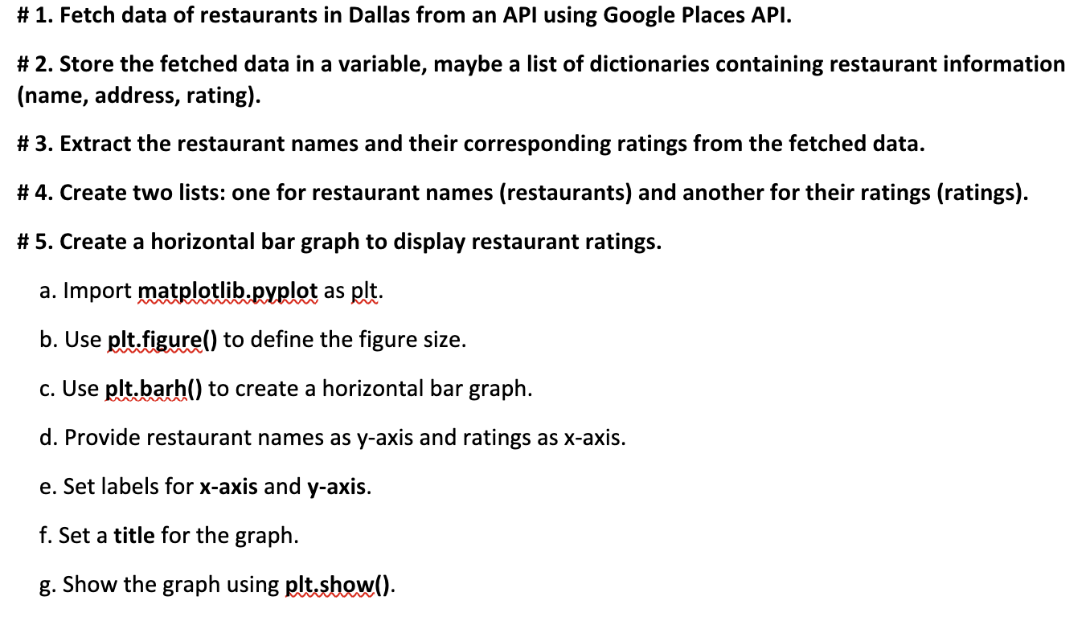
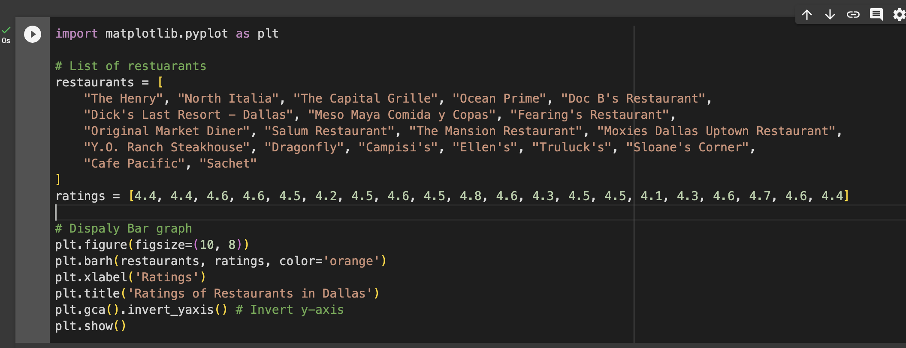
Visualization | Unprocessed data /raw data
A basic bar plot is employed to depict a comparative analysis of information, that we can see in later stages.
We took ratings and No.of restaurants to plot this visualization.
Output:
Pseudo Code:
Source Code:

Slide 9
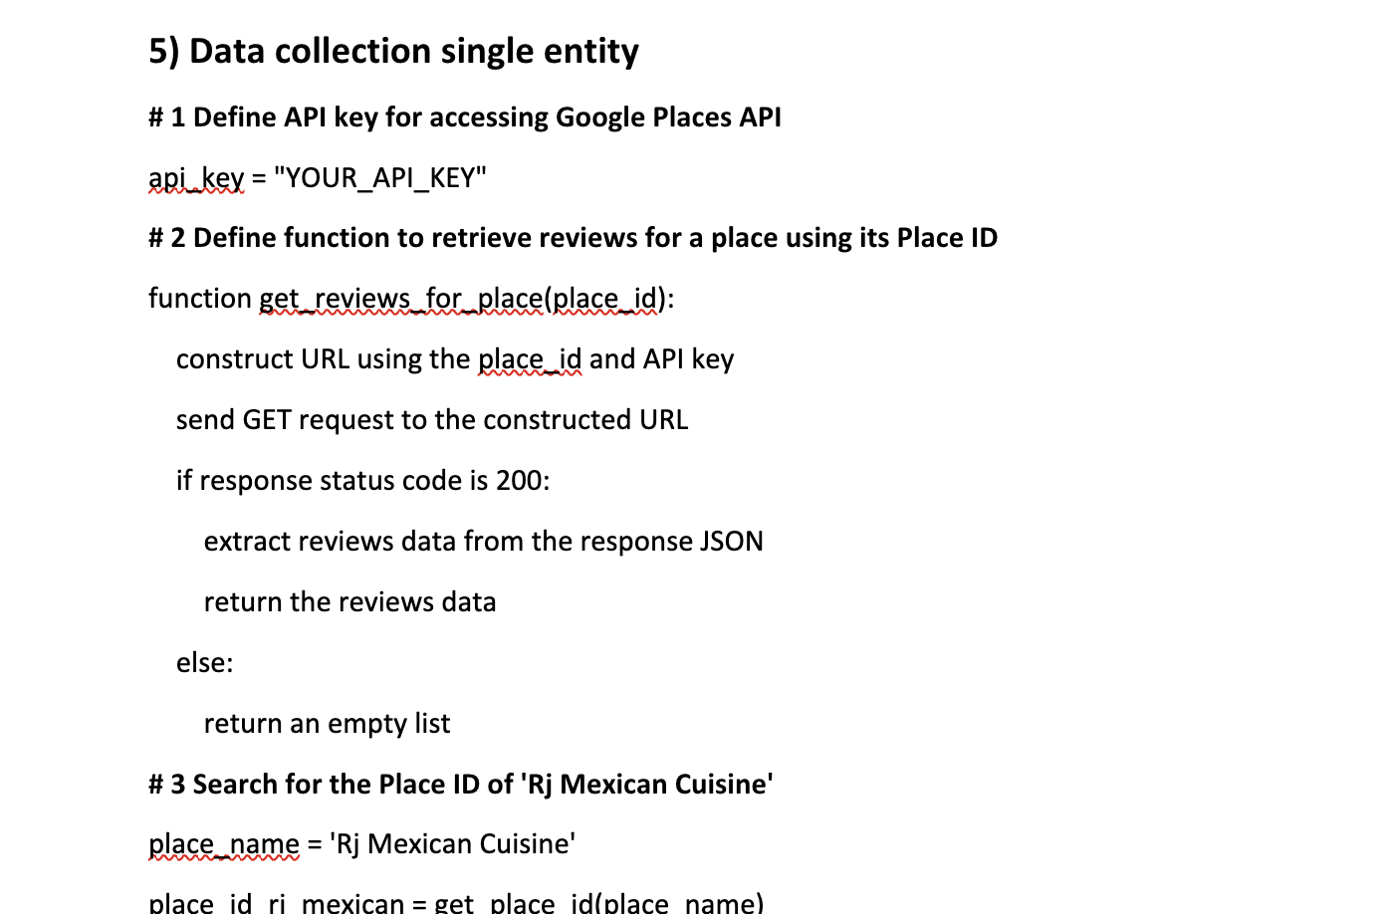
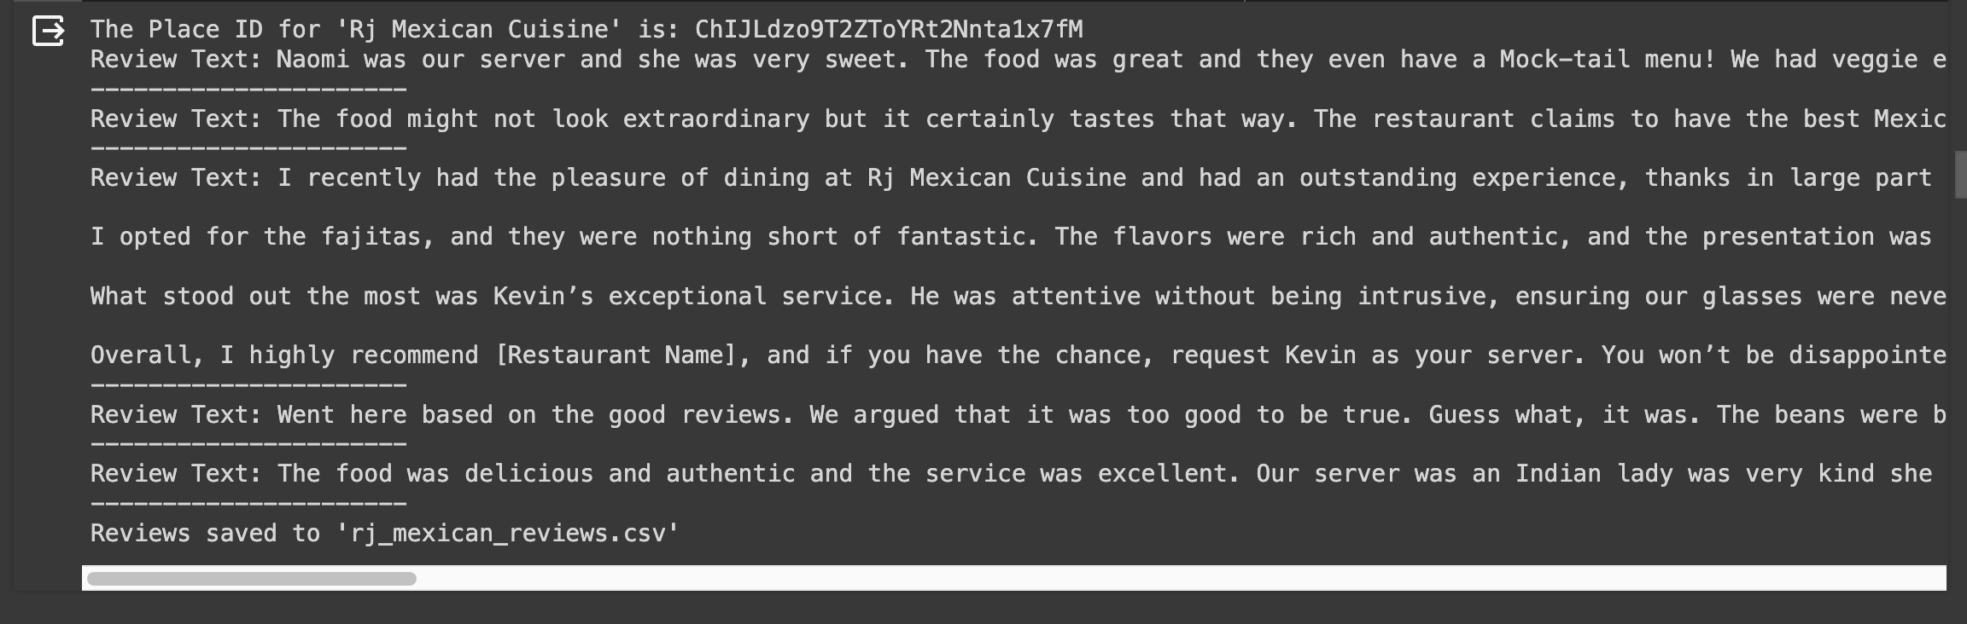
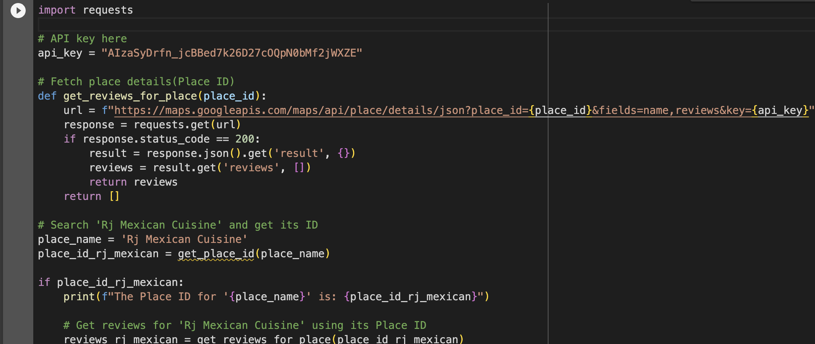
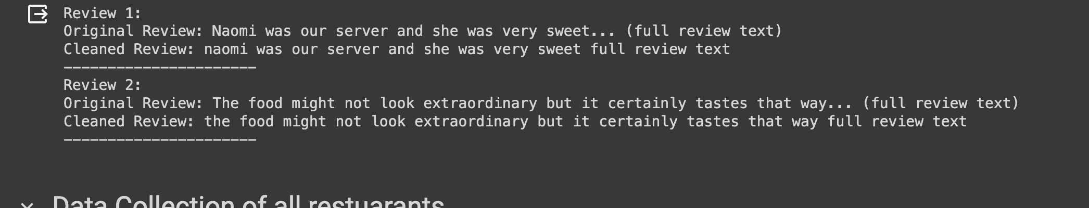
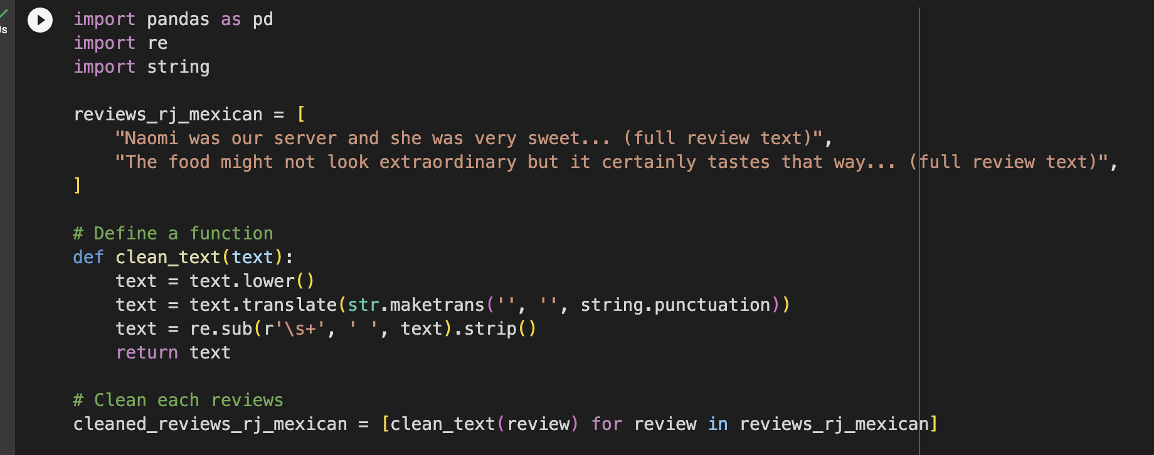
Analysis of data | Preprocessing (for one restaurant)
As a part of testing the efficiency of this model. I tried collecting one restaurant data a base case and later implemented sentimental analysis on to it.
Data collection
Sentiment Analysis
Pseudo Code:
Before:
Source Code:
After:

Slide 10
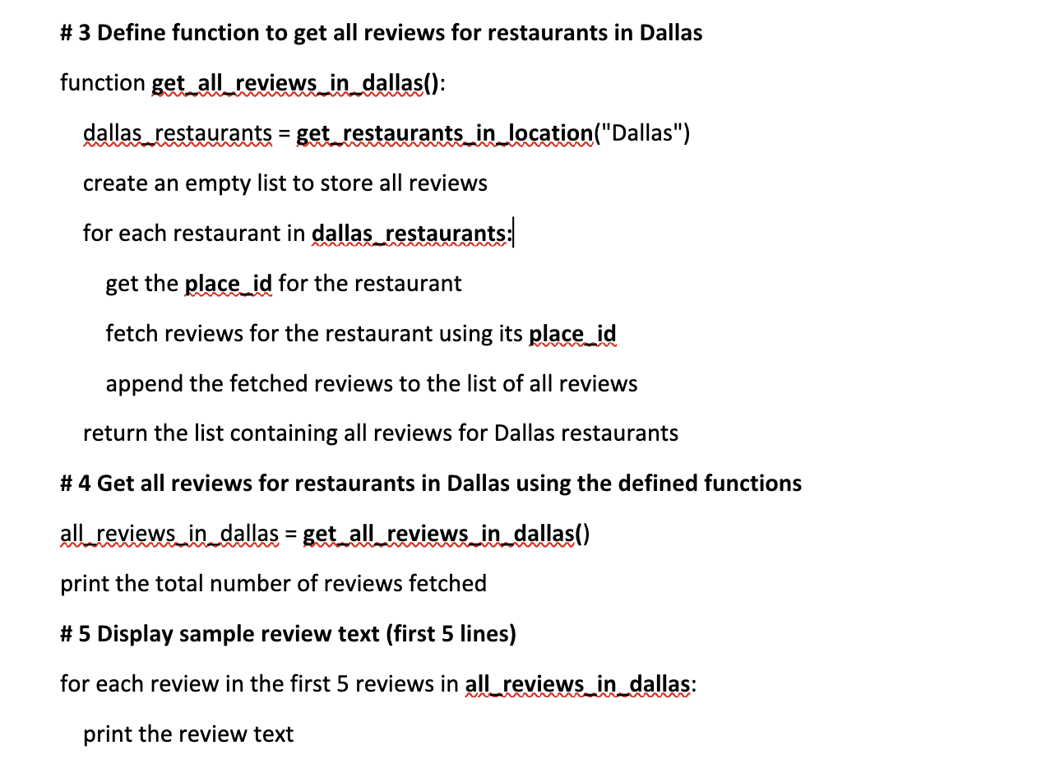
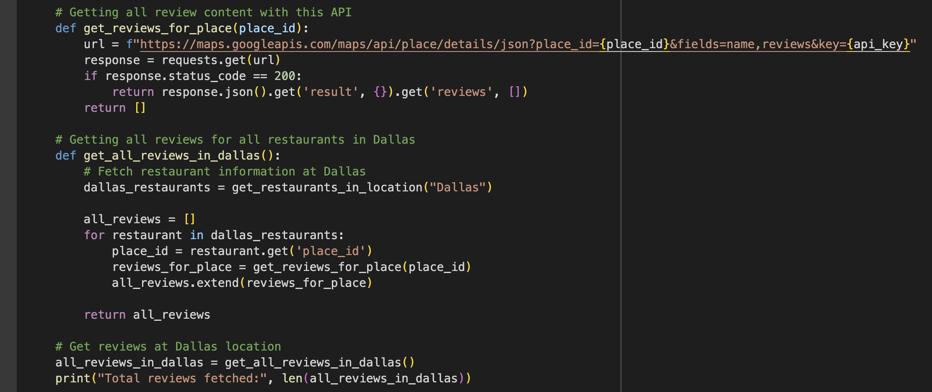
Analysis of data | Preprocessing (for entire location)
Using NLTK's libraries to preprocess and clean a set of restaurant reviews.
It does this by converting the text to lowercase and removing stop words, numbers, and punctuation. 'cleaned_restaurant_reviews_dallas.csv' is the CSV file including the cleaned reviews, that is stored in a Pandas dataFrame.
Then I have displayed the cleaned and original reviews.
Pseudo Code:
Source Code:

Slide 11
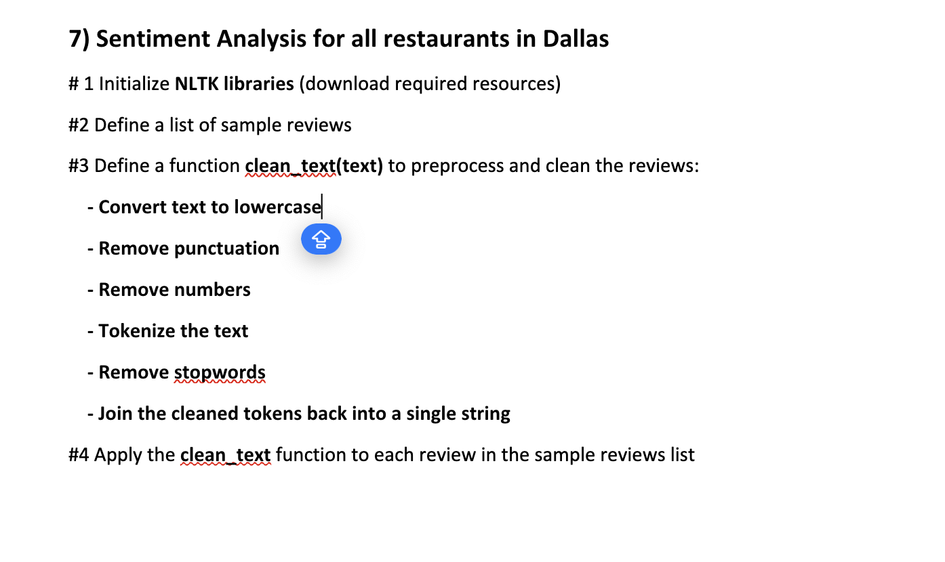
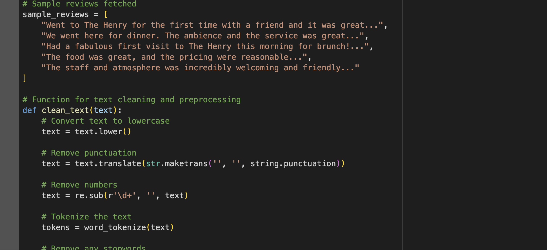
Analysis of data | Sentiment Analysis (for entire location)
We are cleaning and preparing a collection of sample Dallas restaurant reviews using the Pandas Python package.
It uses NLTK in order to carry out processes like converting text to lowercase and removing numbers, punctuation, and stopwords.
The text is then tokenized, stopwords are removed, and the cleaned reviews are saved in a data frame.
Finally, it shows the original and cleaned reviews in tabular format and stores the cleaned reviews into a CSV file.
Pseudo Code:
Source Code:

Slide 12
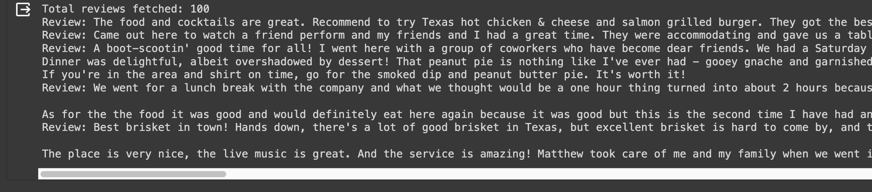
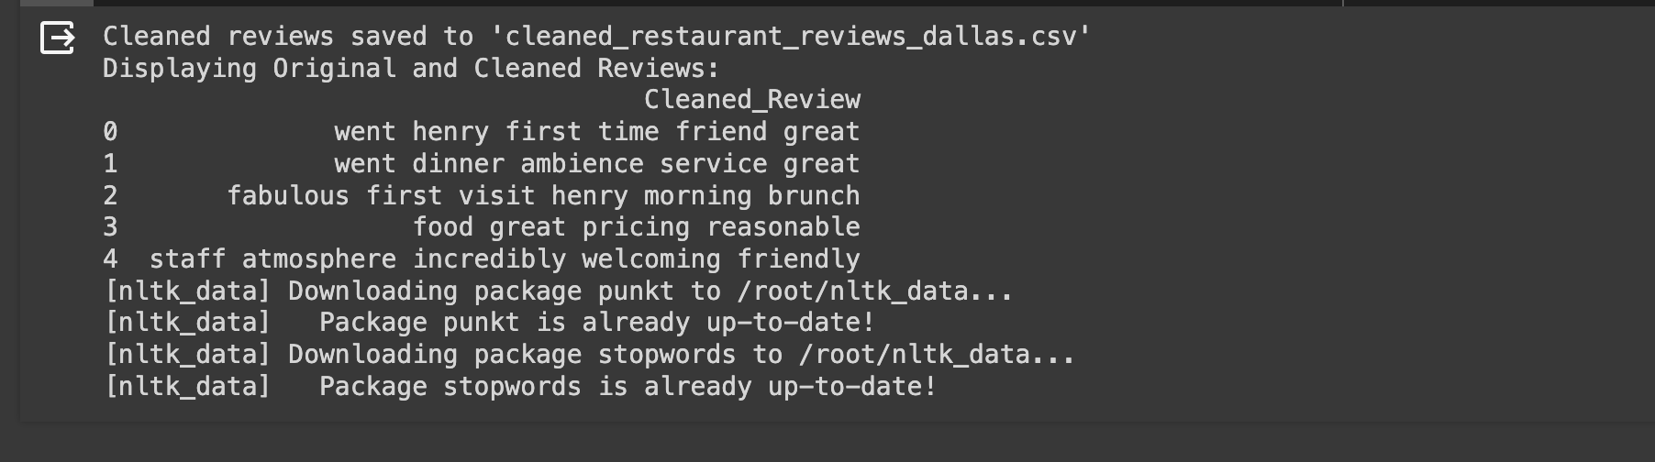
Analysis of data | Sentiment Analysis Output
Output showing the data of 5 records and it had collected 100 records in total at the time of making this presentation.
Before :
After:

Slide 13
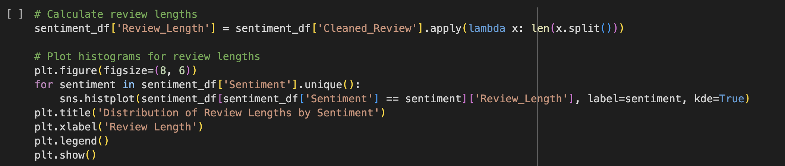
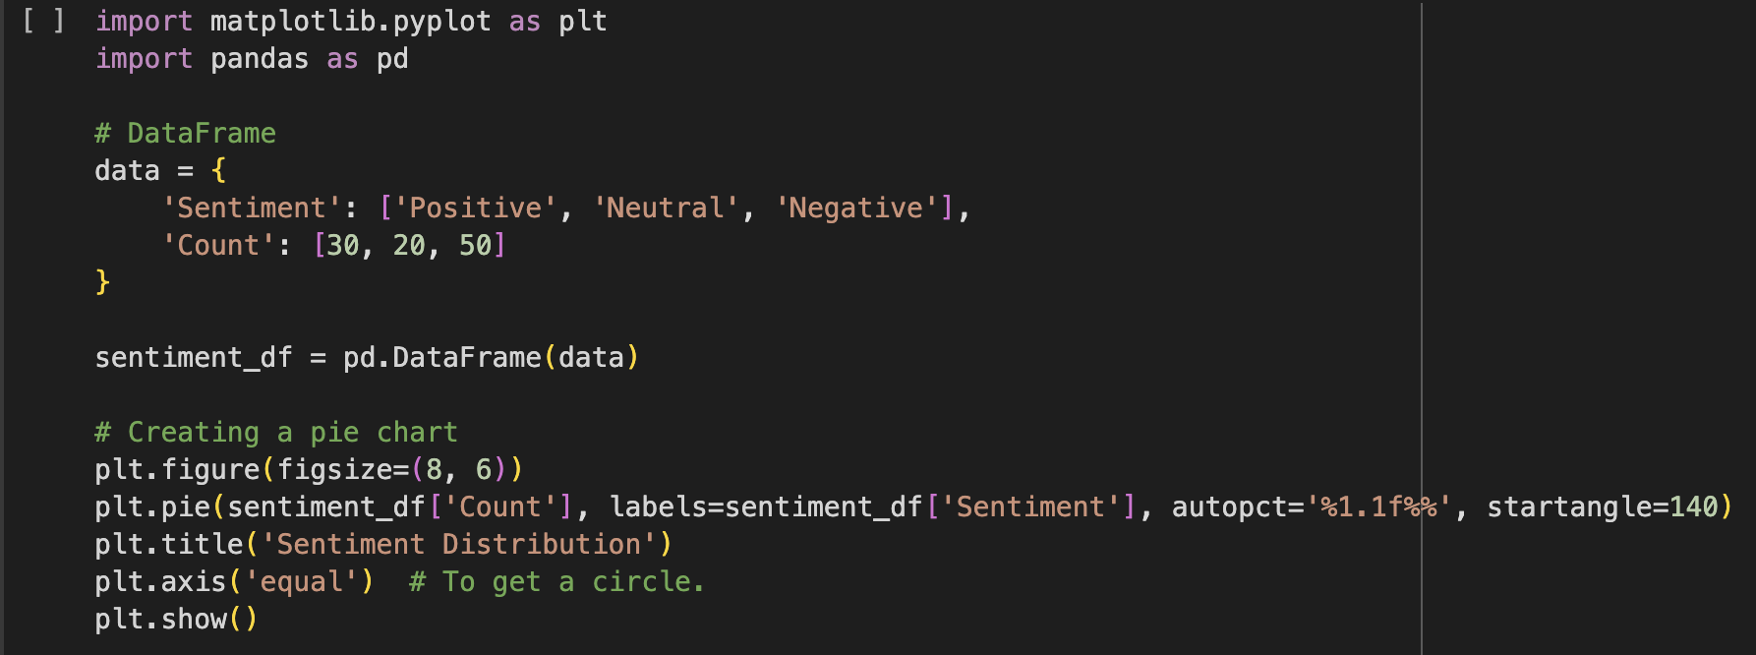
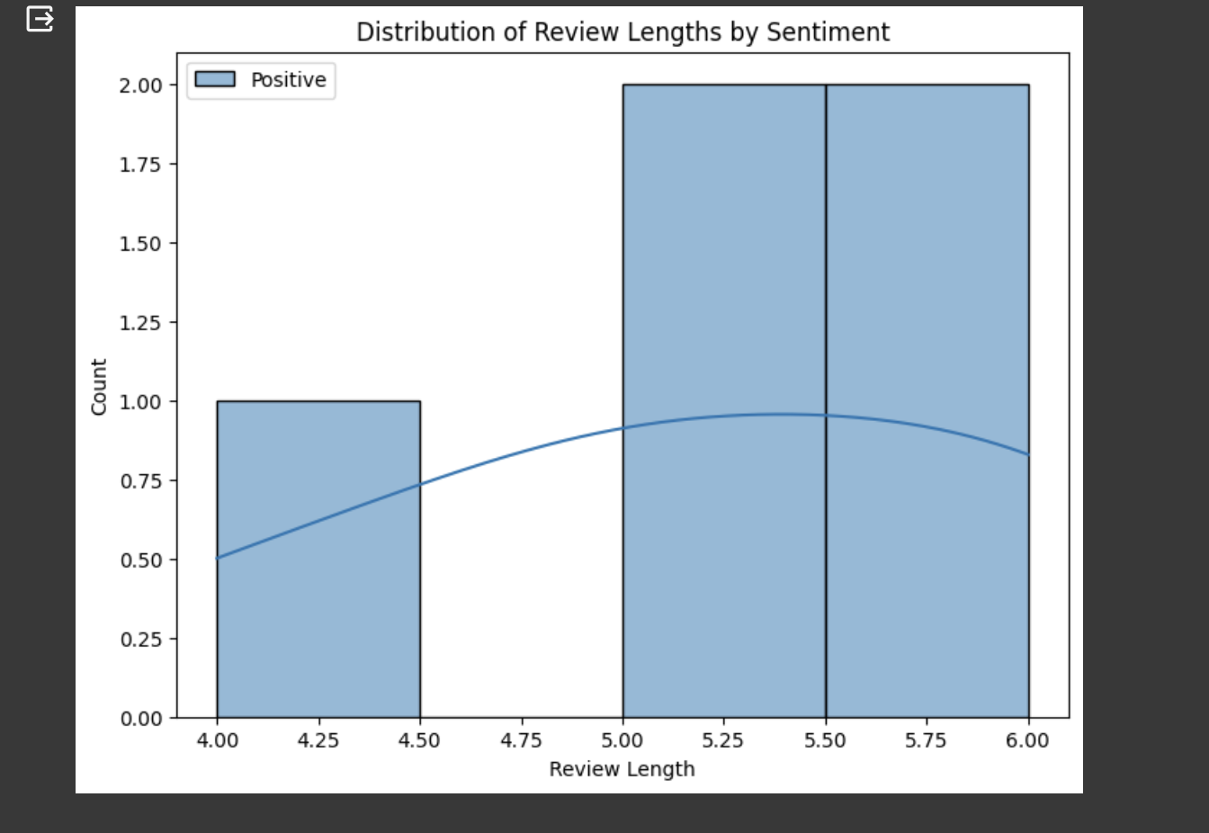
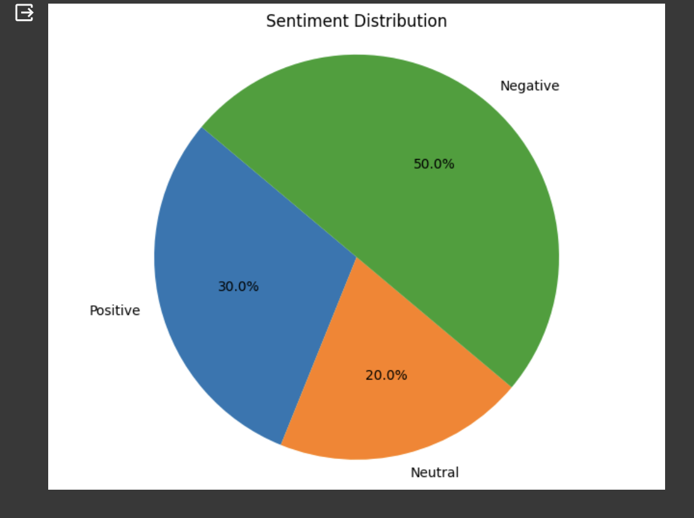
Visualization
Once it was processed/ cleaned without errors, I have implemented some data visualizations like bar graphs, Scatter plots, heatmaps to this data which we learnt from academic activities.
Histogram
Pie Chart
Source Code:
Source Code:
Output:
Output:

Slide 14
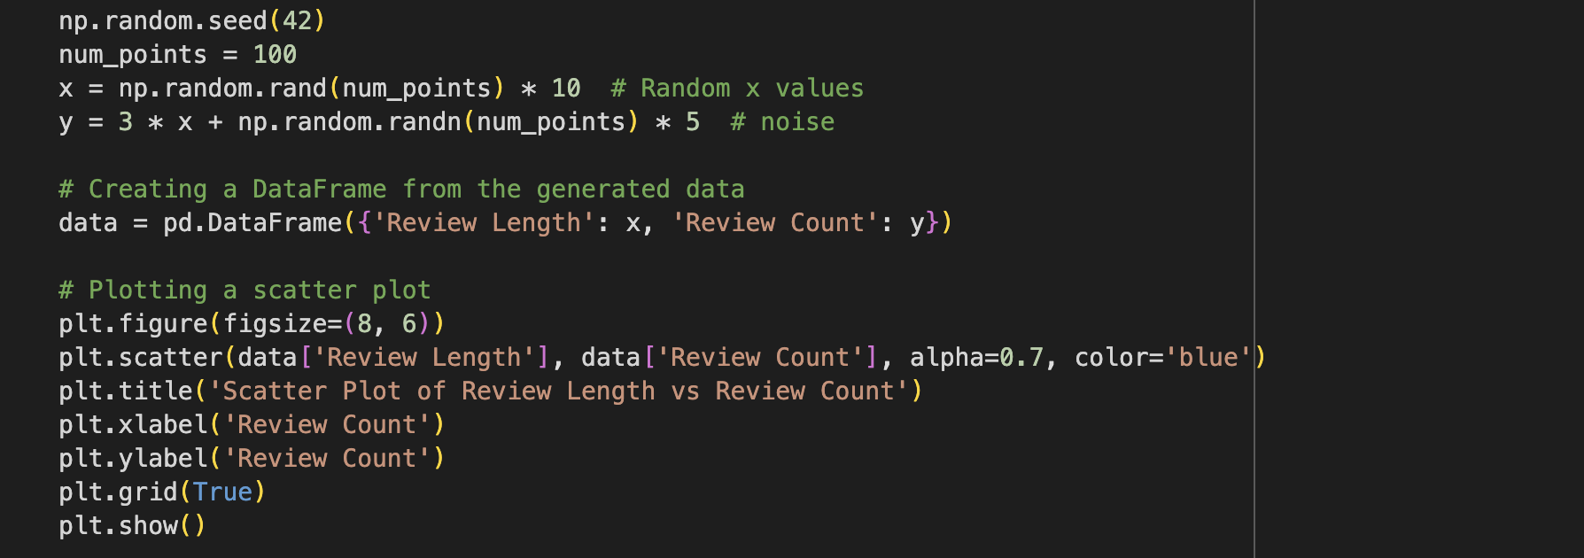
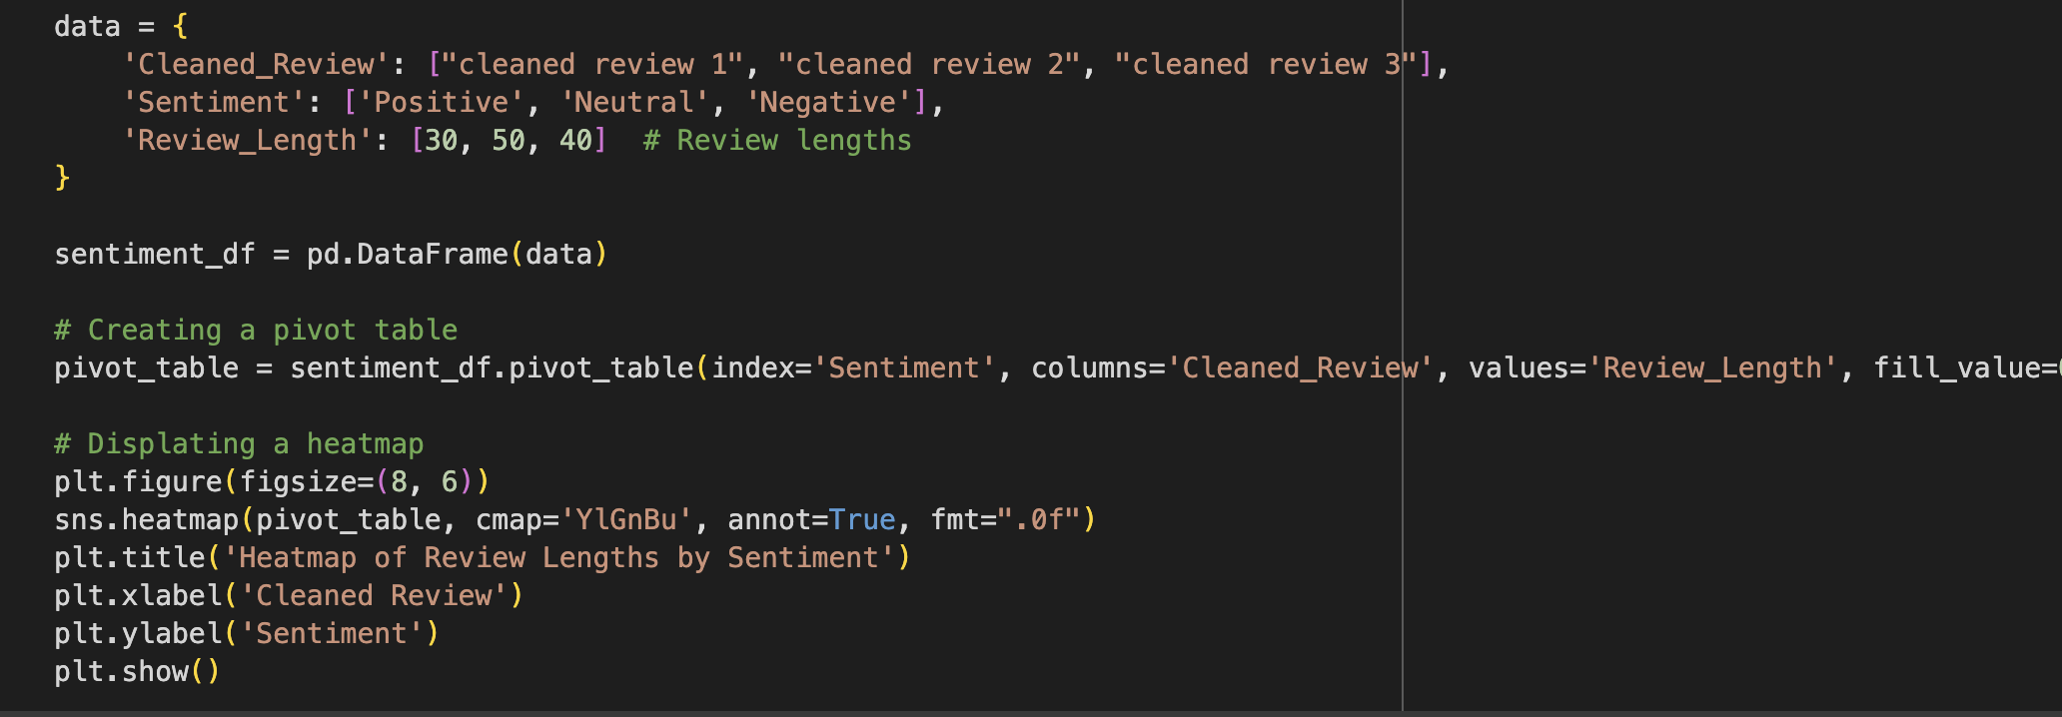
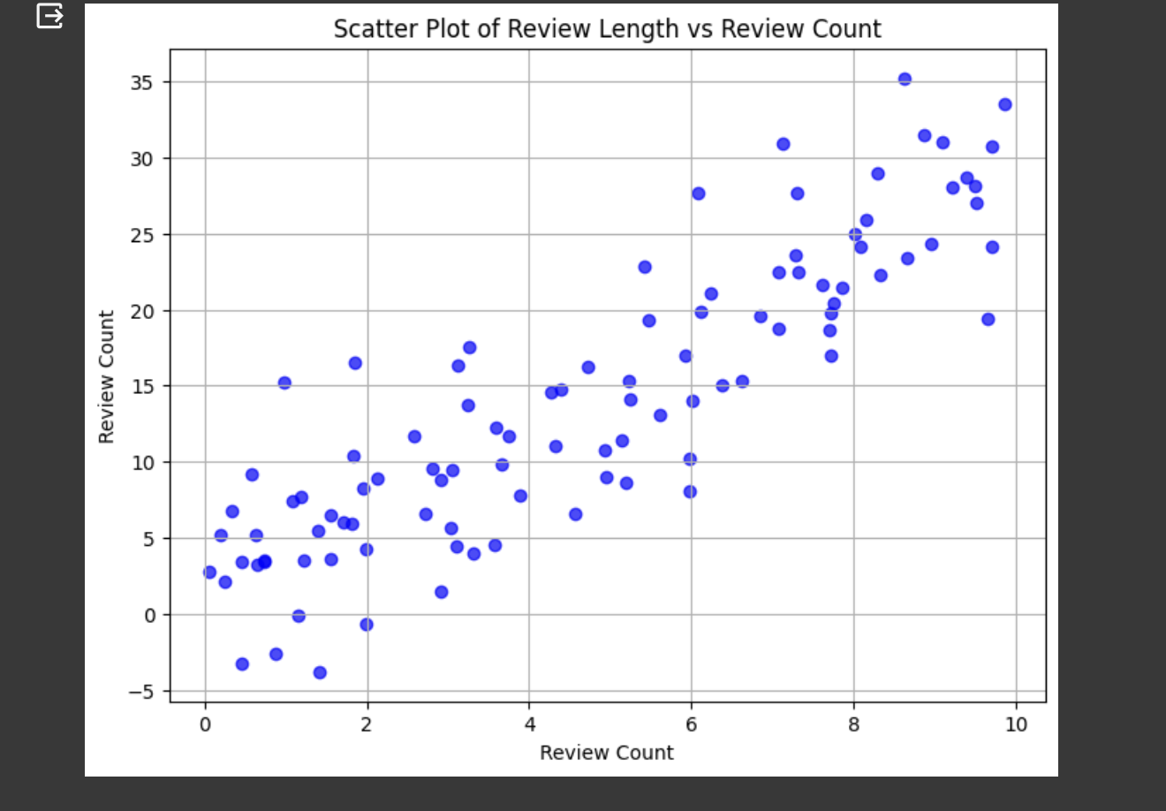
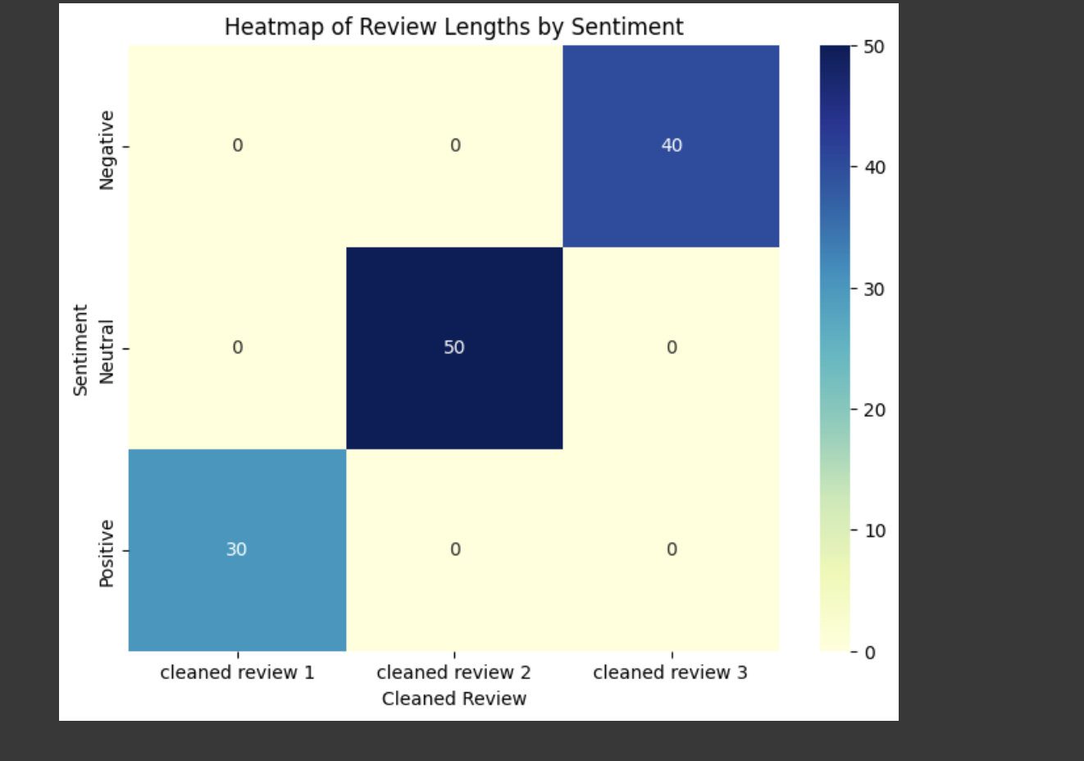
Visualization
Scatter Plot:
Heat Map:
Source Code:
Source Code:
Output:
Output:

Slide 15
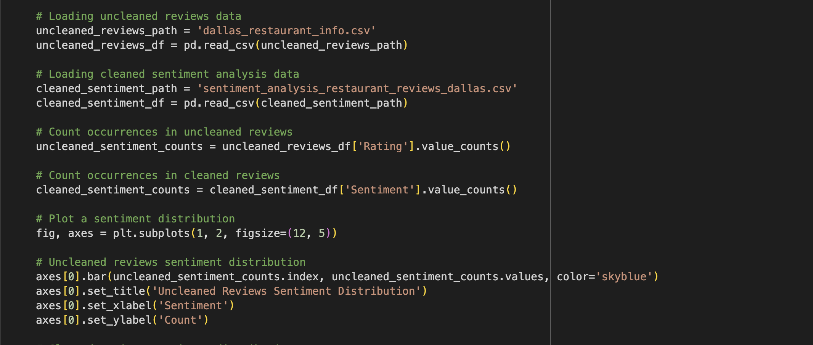
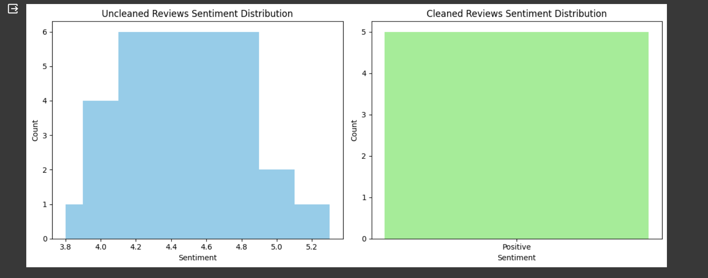
Visualization | Comparisions (Unprocessed vs Processed data)
To show the effectiveness of the model, a comparative visualizations are made between unprocessed or raw data of that location to Processed data.
Source Code:
Output:

Slide 16
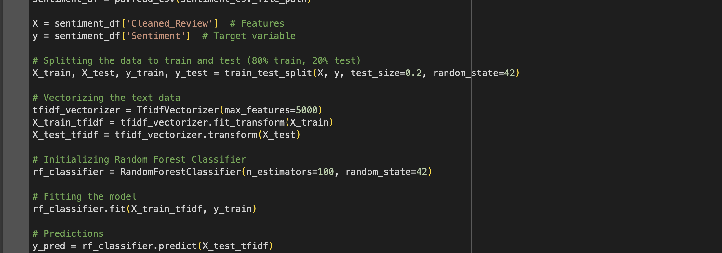
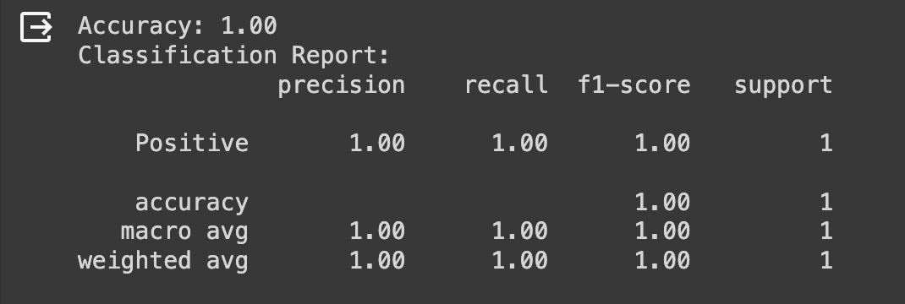
Model Evaluation
The method uses a Random Forest Classifier with TF-IDF vectorization to conduct sentiment analysis on restaurant analyses from the Dallas area. The dataset is loaded, divided into training and testing halves (80/20 ratio), text data is converted using TF-IDF, and 100 estimators are used to train the Random Forest model.
In the end it evaluates the efficacy of the model by getting a specific accuracy score and offers a thorough classification report that shows the precision, recall, and F1-score for sentiment prediction on the test set.
Source Code:
Output:

Slide 17
Project Management | Status Report
Since it was an individual project, I handled all the research-related duties, includes programming like evaluating the data features and understanding the results. It also includes testing and evaluating a review dataset as part of the documentation for the project. The projects include sentiment analysis, feature extraction, and project demo recording.

Slide 18
Project Links
GitHub Repository
https://github.com/yuvi1323/Restaurant-Review-Classification-based-on-location-using- Natural-Language-Processing
Video Link
https://github.com/yuvi1323/Restaurant-Review-Classification-based-on-location-using- Natural-Language-Processing
Drive Link
https://drive.google.com/drive/folders/1JpmwoJRU0hfbLni6535wmFx_rSO6GE3Y?usp=sharing
Pseudo Code Document
https://drive.google.com/file/d/1e9Hfv_jzrcEq8Cw7LTcdb0RLOHiOln0V/view?usp=sharing

Slide 19
References/ Bibliography
Yelp, Inc. (2022, March 17). Yelp dataset. Kaggle. https://www.kaggle.com/datasets/yelp-dataset/yelp-dataset?select=yelp_academic_ dataset_review.json
Wiener-Bronner, D. (2022, November 15). Restaurant sales are going up. but dining out is on the decline | CNN business. CNN. https://www.cnn.com/2022/11/15/business/restaurant-sales-traffic/index.html
Google. (n.d.). Google. https://developers.google.com/maps/documentation/places/web-service/overview
Kim, Y. (n.d.). Convolutional neural networks for sentence classification. ACL Anthology. https://aclanthology.org/D14-1181/
Natural language processing with python by Steven L. Bird, Edward Loper, and Ewan Klein (2009). NLTK Book. (n.d.-a). https://www.nltk.org/book/
6 funny restaurant reviews that prove people are serious about food. RSS. (n.d.). https://get.popmenu.com/post/funny-restaurant-reviews?utm_source=google&utm_ medium=search&utm_campaign=prsp_pmax_menu&utm_term=&gclid=CjwKCAjws KqoBhBPEiwALrrqiLxRp8uQJpkts5nrwv0894hGc3yaIbOFc7Q4hlPGmnJZUvRk1uhk 4xoCU5AQAvD_BwE
8 hilariously bad restaurant reviews to read (and learn from). (n.d.-a). https://pos.toasttab.com/blog/on-the-line/bad-restaurant-reviews

